Slide 1
CIC Global 2025
ADE Copilot – Intelligent Optimization Engine Based On LLM
Pengcheng Xin

Slide 2
Overview

Slide 3
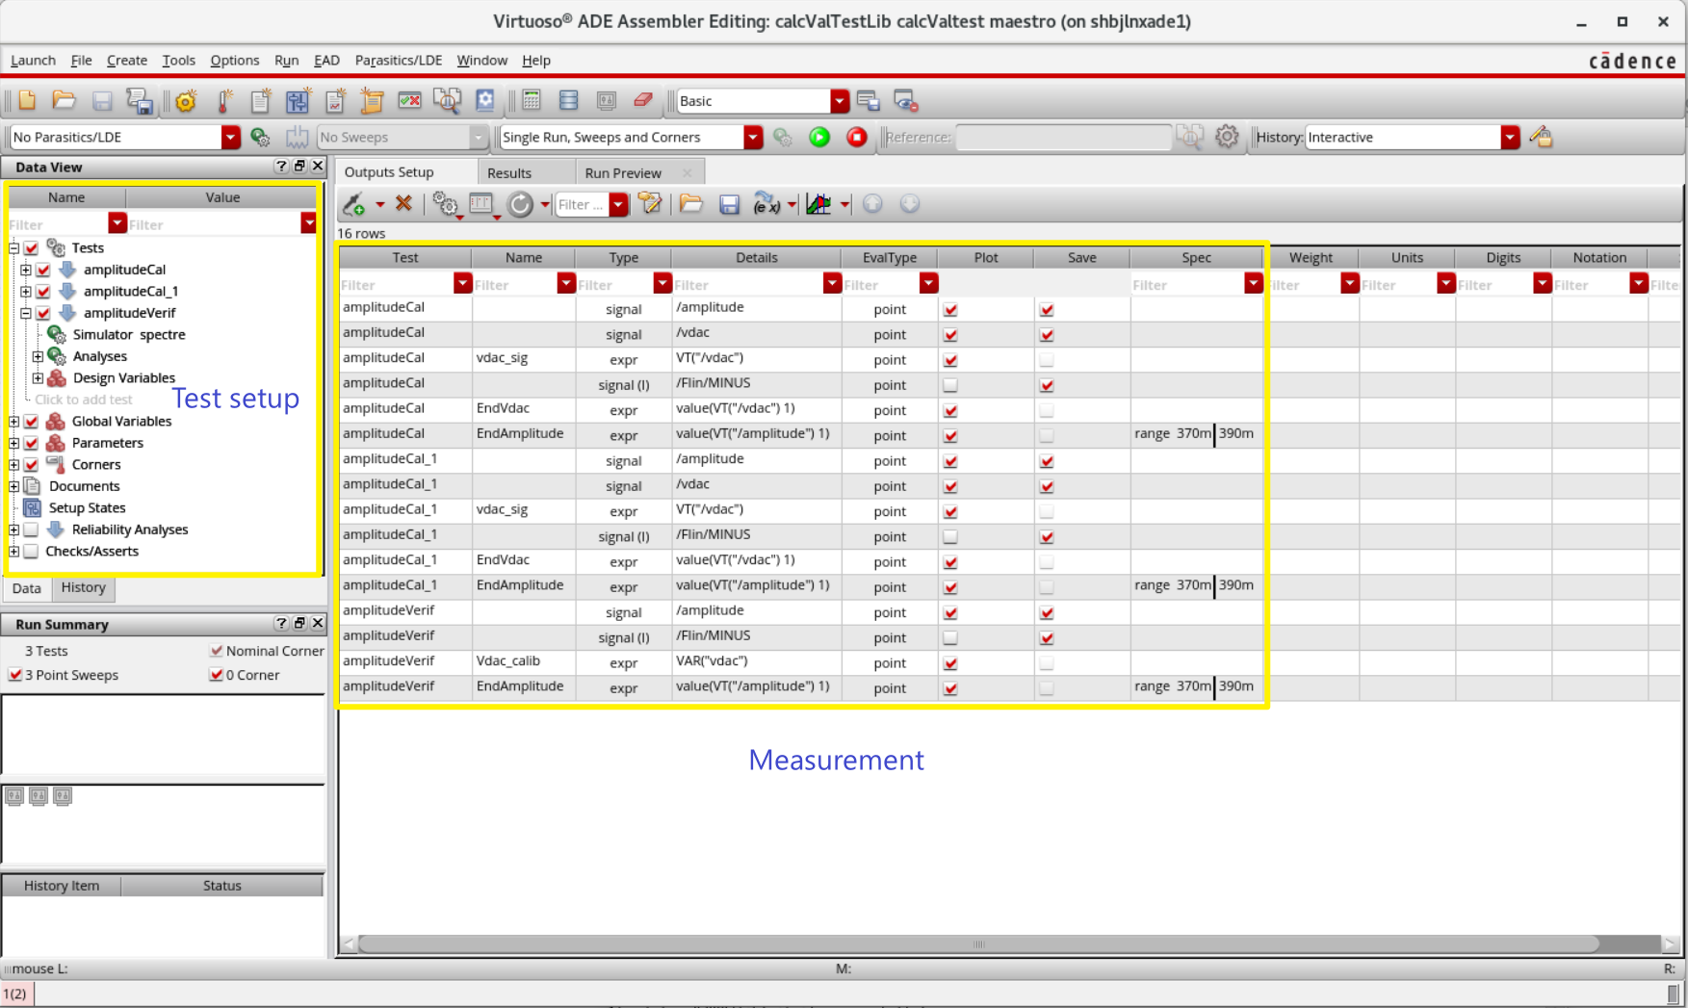
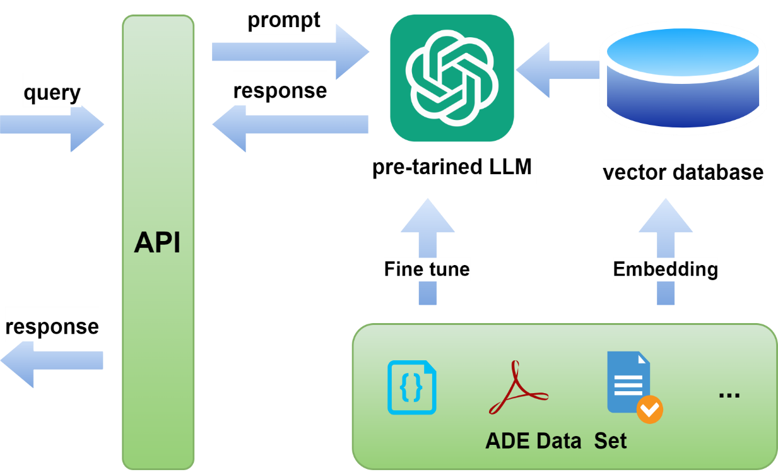
What’s ADE Copilot
ADE(Analog Design Environment)’s intelligent optimization engine
Based on LLM(Large Language Model)
Optimize user experience and improve simulation performance
ADE
Copilot

Slide 4
Architecture

Slide 5







Architecture
Controller
REST APIs
Designer
ADE GUI
Chat Engine
Query Router
JEDAI LLM
Services
Agents
Doc Agent
SKILL Generation
Agent
Virtuoso LLM
(Default)
Testbench
Agent
Planning Agent
Retrieval
Designer in the
loop plan refinement
Commercial
LLM
r DB
r DB
Refinement
Planning
SKILL Checker
Customer Vector DBs
Cadence Vector DBs
Customer
LLM
Customer
Documents
SKILL Code
Virtuoso
Documents
APIs
SKILL Code
Execution
ADE
VSE
VXL

Slide 6




Fine Tuning
Virtuoso Domain Knowledge
Public Benchmark Datasets
SKILL
TXT
Domain Adaptation
MMLU
HumanEval
Chunking
…
Document Chunks
Unsupervised Datasets
Updated LLM
Instruction Training
Accuracy Testing
Labeled Datasets
Alignment Training
Internal
Test Datasets
Images: Flaticon.com, Freepik
Notes:
Given the relatively small size of the Virtuoso knowledge base, we use Parameter Efficient Fine Tuning (PEFT), which trains an adapter with a small number of parameters, rather than full fine tuning, which adjusts all of the weights in the model.

Slide 7

Retrieval Augmented Generation
Designer
Question
Embedding
Question Vector
LLM
Answer
Generation
Similarity
Search
Virtuoso Domain Knowledge
Document Chunks
Chunking
Embeddings
Top k relevant chunks
SKILL
TXT
Cadence Vector DBs
Customer Domain Knowledge
Document Chunks
Chunking
Embeddings
SKILL
TXT
Customer Vector DBs
Images: Flaticon.com, Freepik
Notes:
RAG is an essential approach for improving accuracy and incorporating customer-specific domain knowledge. Although it is theoretically possible to do additional fine tuning on-site at a customer with their data, the logistics are challenging, and we do not currently expect this to be necessary.

Slide 8
Applications
Notes:
This section shows two applications that are currently under development targeting an initial release in 1H2025. By the time of CIC, we expect to develop additional applications based on customer input.

Slide 9
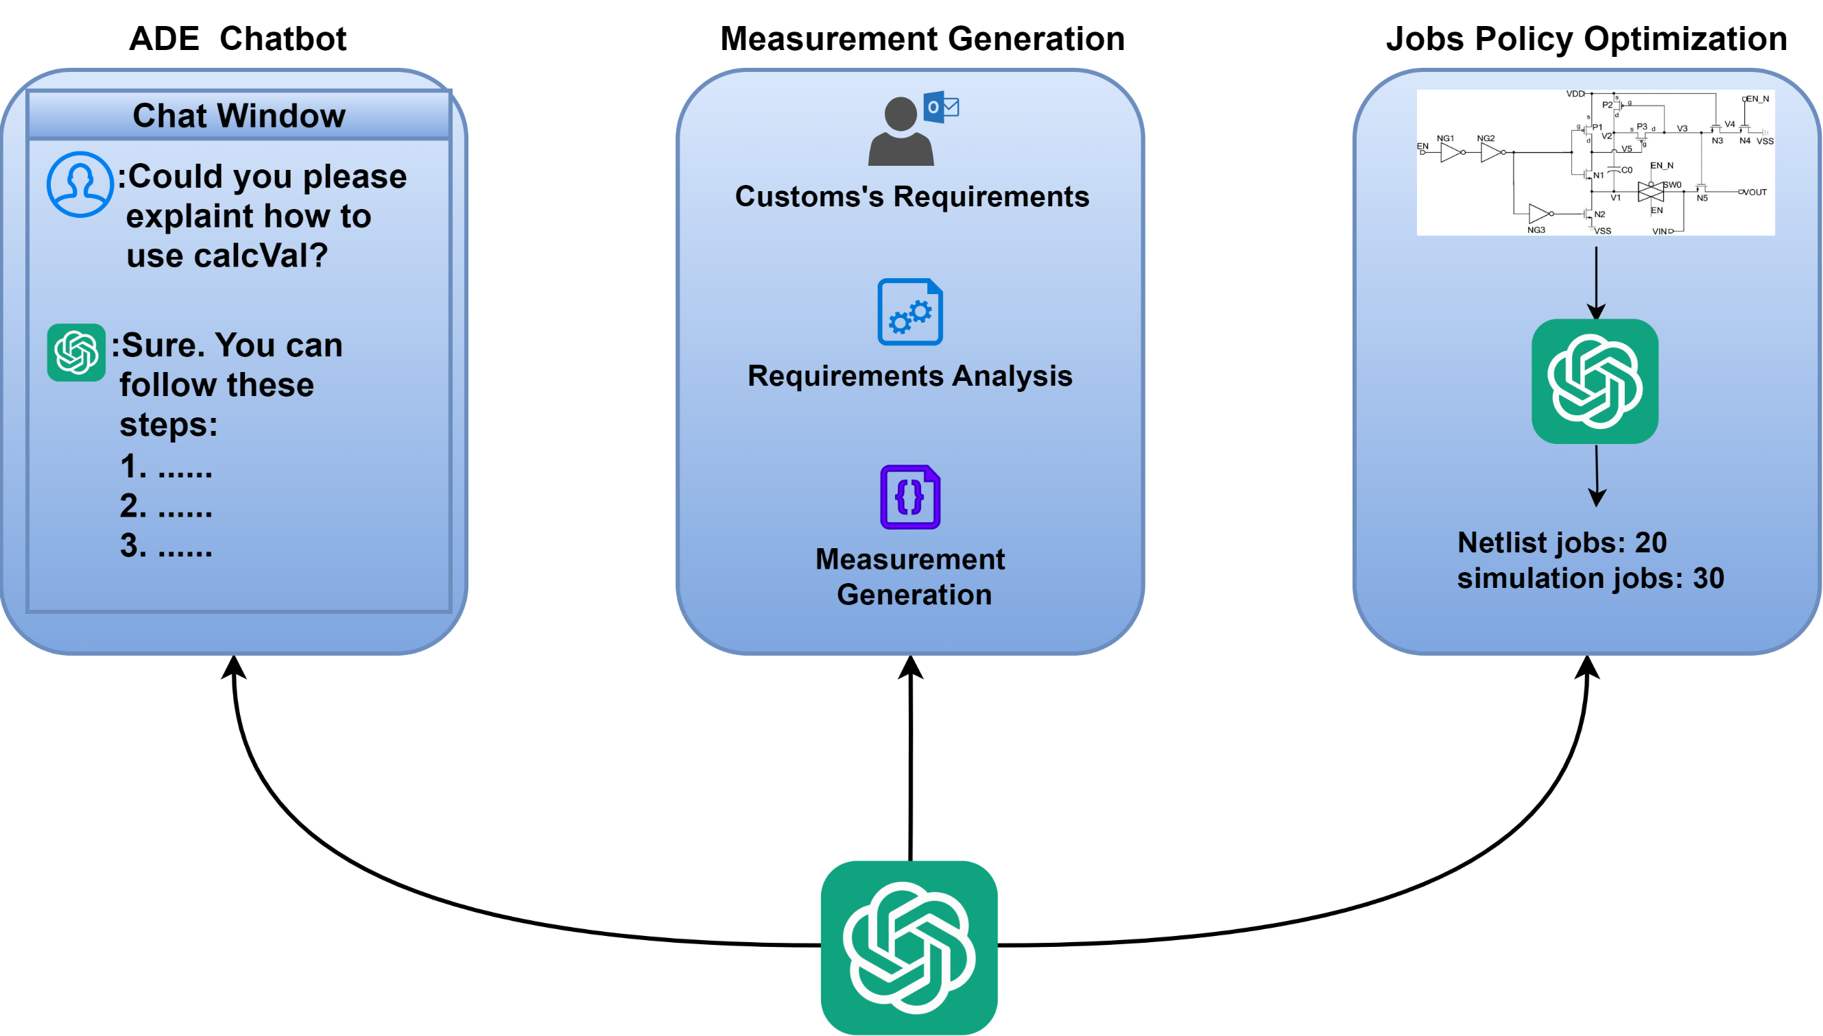
What ADE Copilot can do

Slide 10
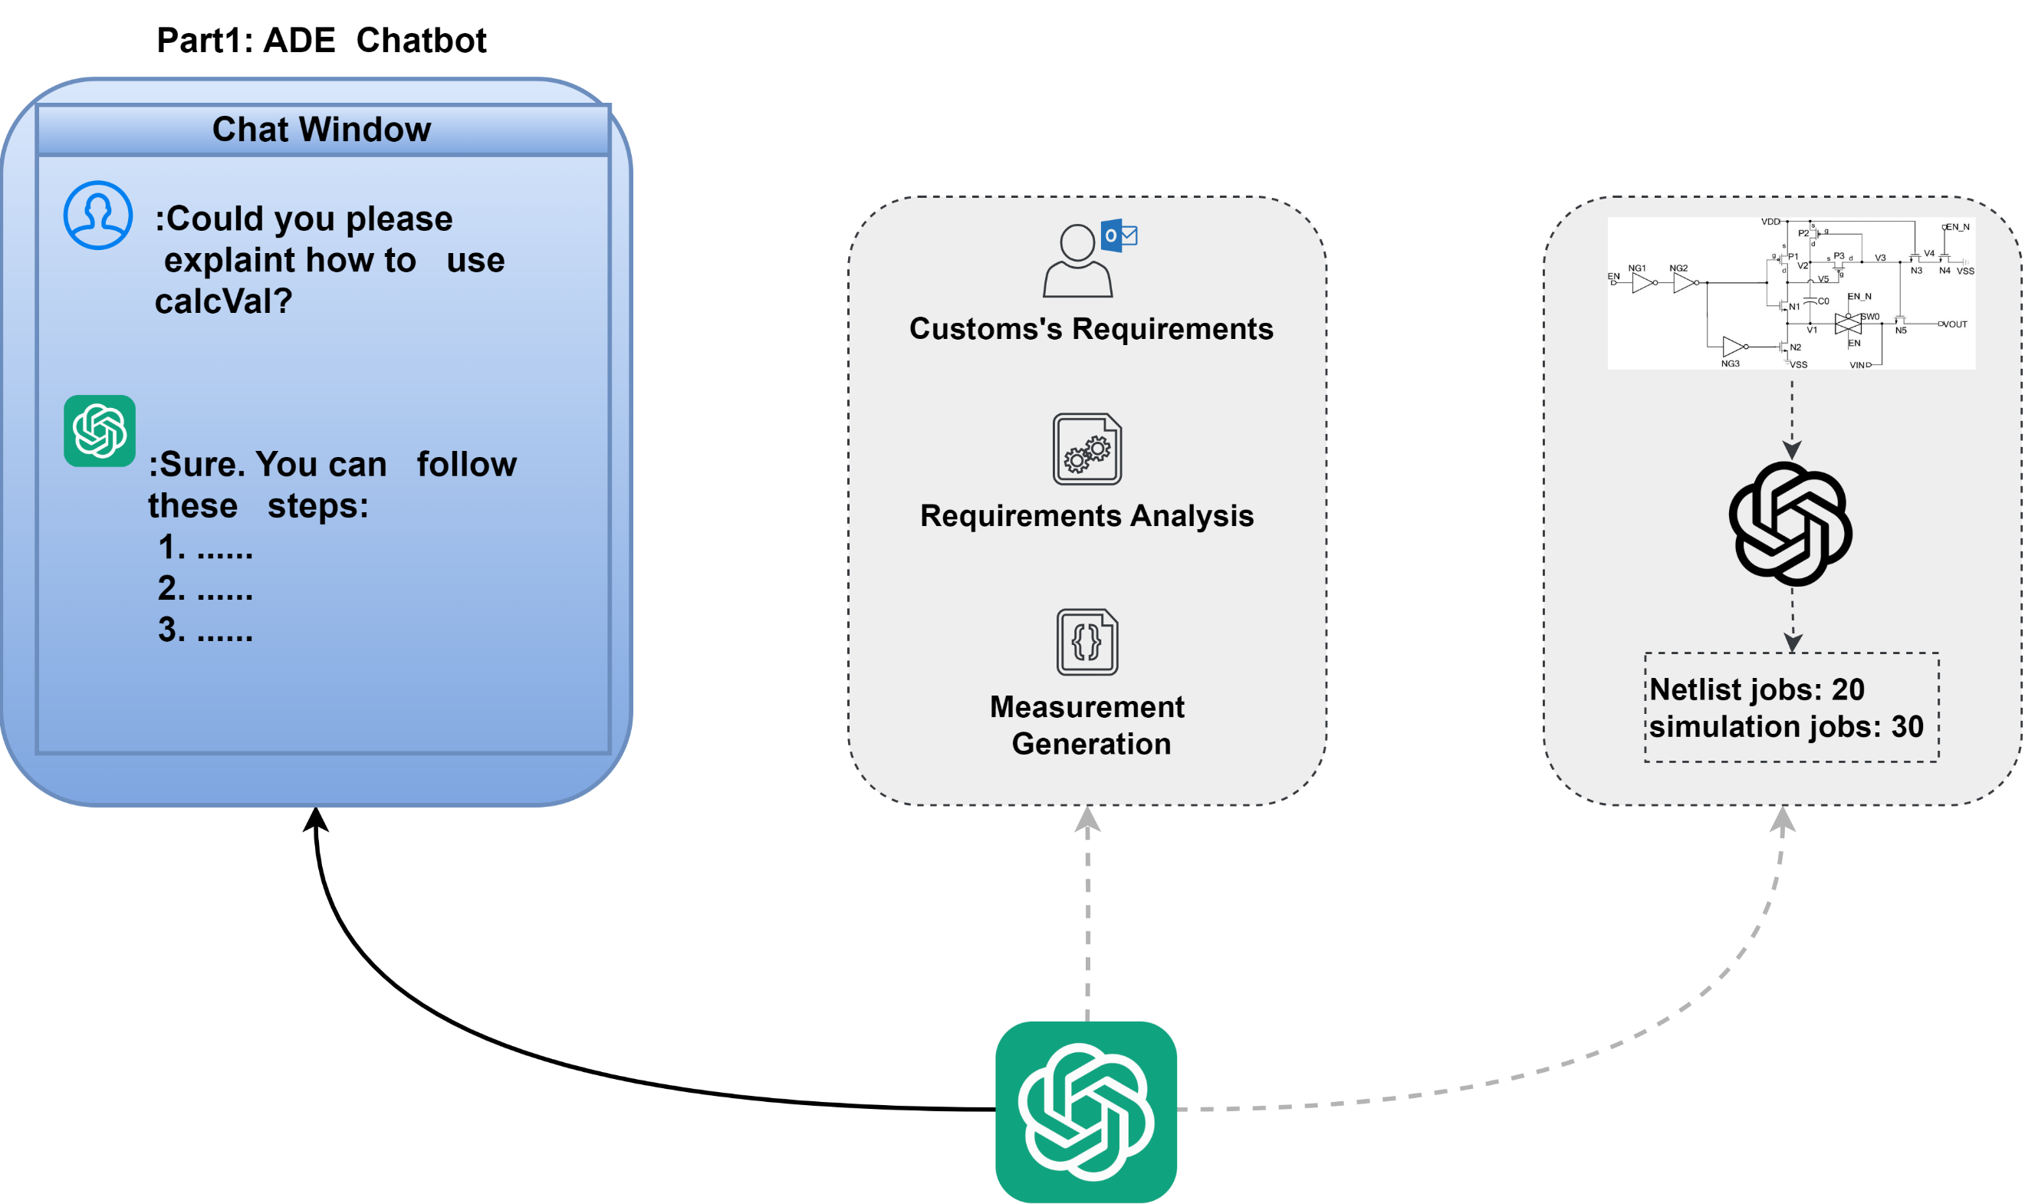
ADE Chatbot

Slide 11
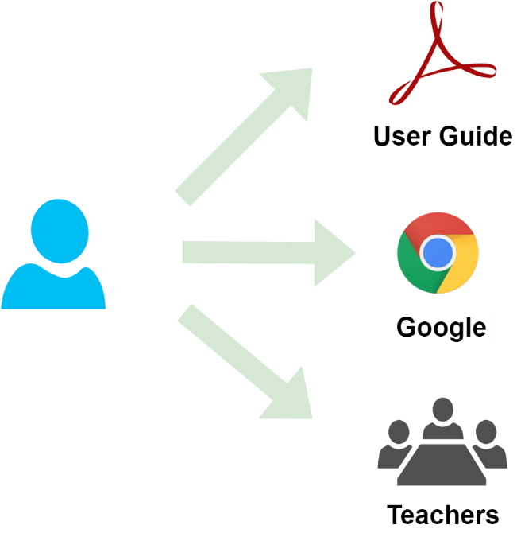
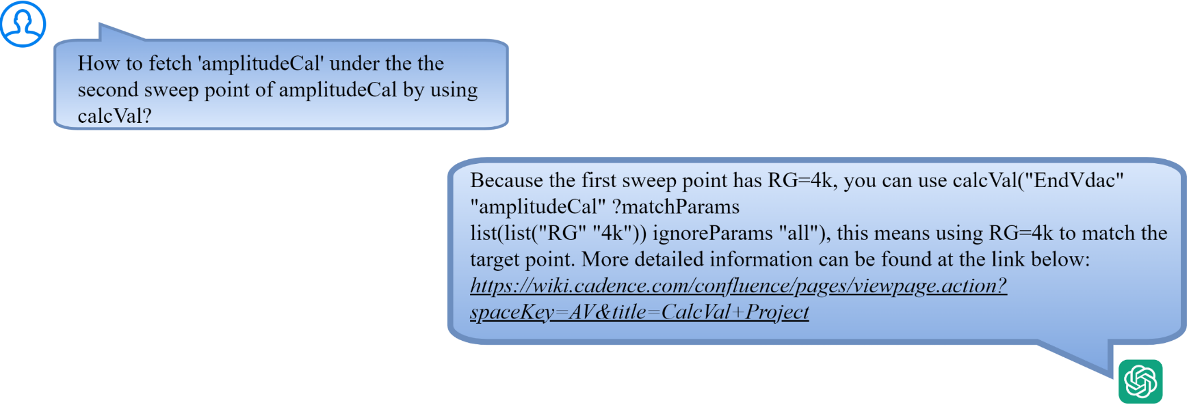
ADE Chatbot
Problem to resolve
ADE has many complex features and are related to each other.
Traditional learning methods can no longer meet the needs
An interactive engineering assistant based on LLM is a better choice
Traditional Learning Methods
Interactive Engineering Assistant

Slide 12
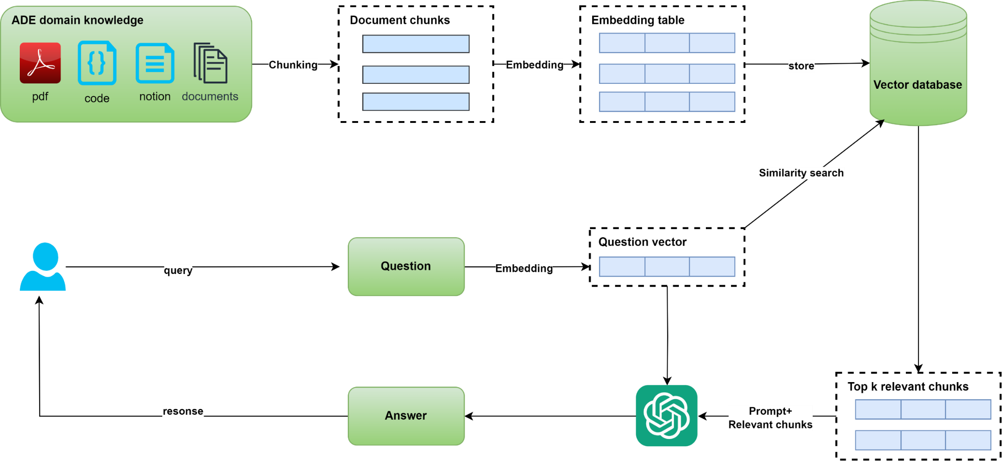
ADE Chatbot
How ADE Copilot solves this problem
Implement interactive engineering assistant based on pre-trained LLM(Large Language Model) and RAG(Retrieval Enhancement Generation)

Slide 13
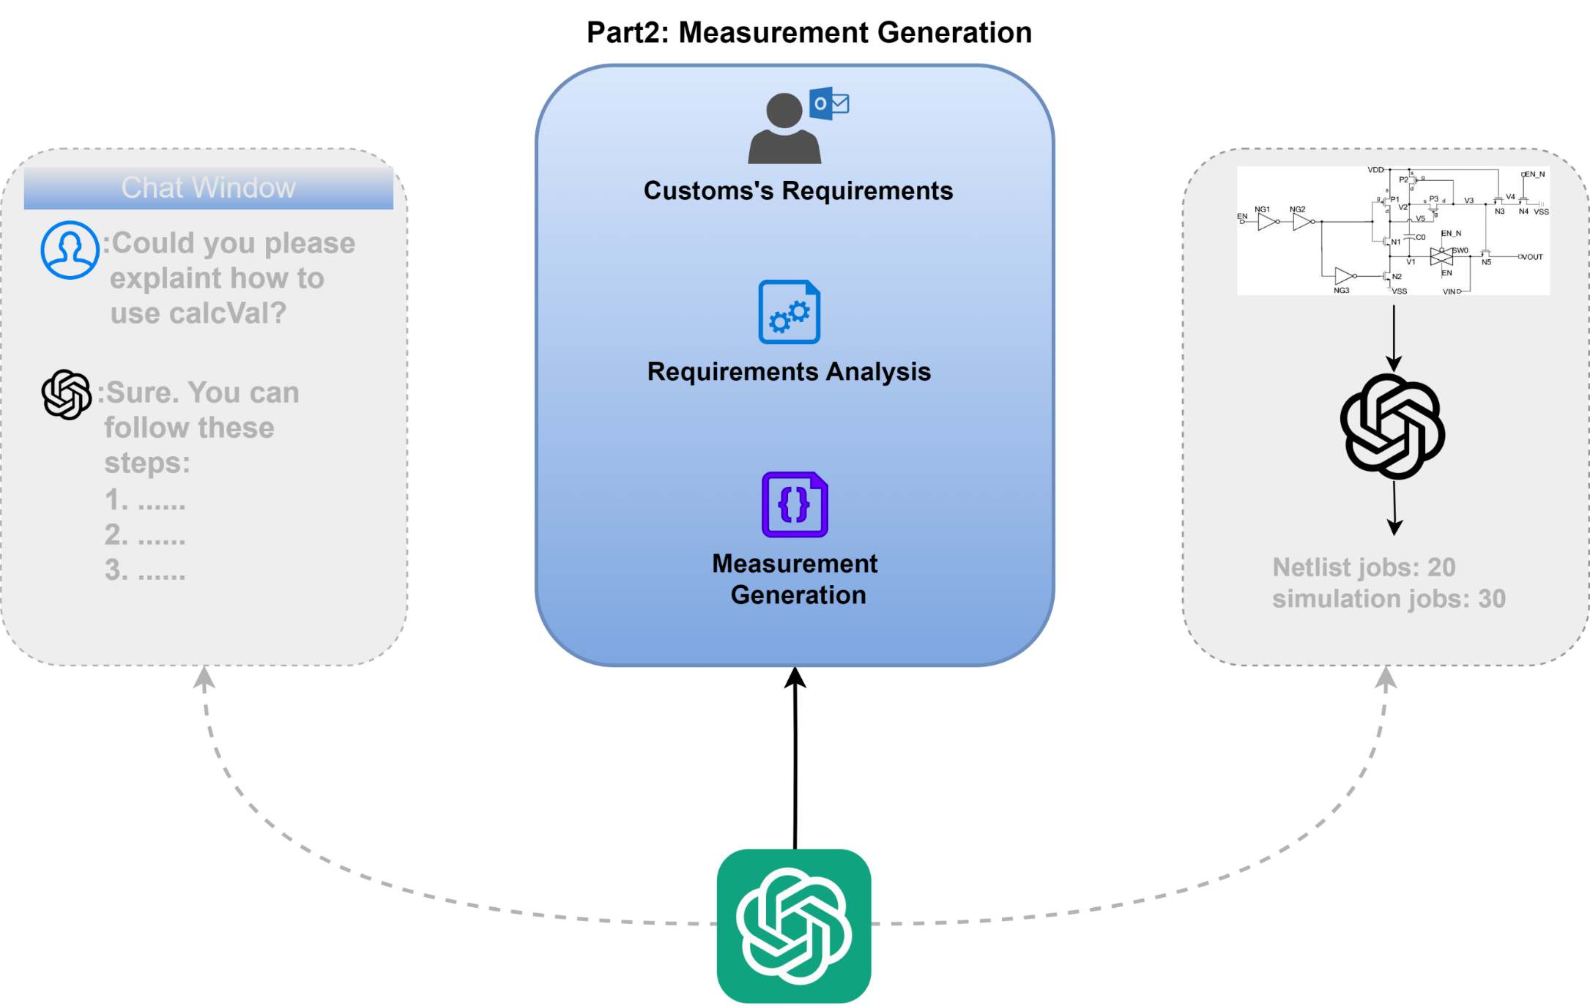
Measurement Generation

Slide 14

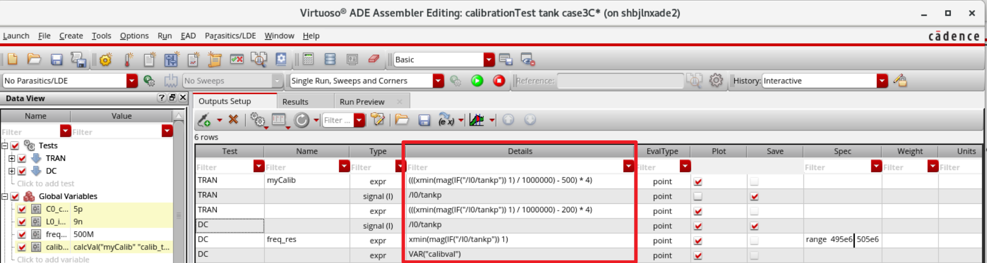

Measurement Generation
Problem to resolve
Turn the custom’s requirements into skill code measurement
Priority | Sim Type | Simulation Name | Simulation Description | Measurements | Corners
2 | TRAN | Functional | Verification of all functional modes | – Check diff amp and CMOS modes – Check SE vs Differential mode of operation – Effect of POC signal – Effect of RX_DQ_EN – ATB functionality - Effect of POC* signals | SS, FF, extreme VT
1 | DC | Power | Active power in all modes; leakage in disabled modes. Power is measured using a 110011 bit pattern at 533Mbps | Measure current/power for each supply Tstart | Power corners
2 | … | … | … | … | …
Natural Language Processing And Skill expression Generation
AI Way
Heavy Manual Effort
Traditional Way

Slide 15
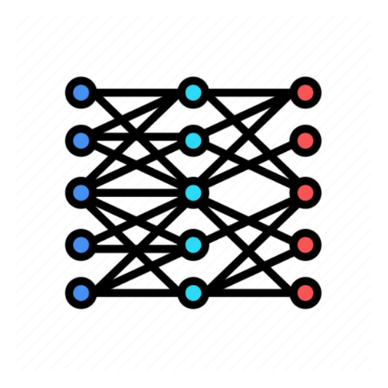
Measurement Generation
How ADE Copilot solves this problem
Fine Tune Pre-trained LLM based on skill source code
ID | Instruction
1 | Returns the X value where a signal crosses the threshold Y value
2 | Computes the average of a waveform over its entire range
3 | Stores the output value from one test and passes it on to another test.
… | …
X
ID | Ref Method
1 | cross(v("1" ?result "tran") 2.5 1 "either" t "time" )
2 | average(v("out" ?result "tran-tran"))
3 | calcVal(“trim” “myTest”)
… | …
ADE Copilot Training
Y

Slide 16
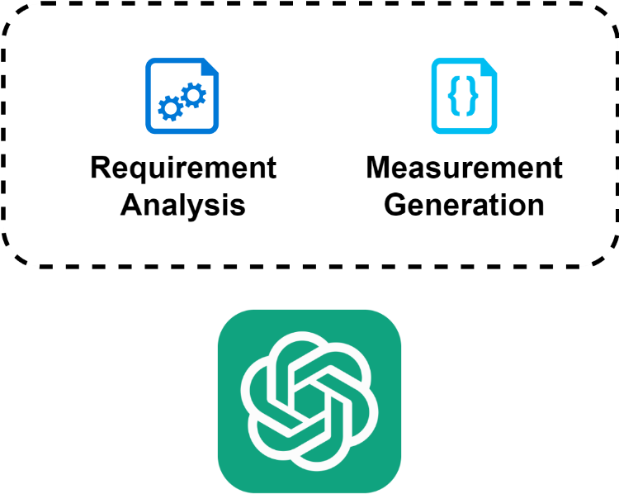
Measurement Generation
How ADE Copilot solves this problem
Task analysis and measurement generation
ID | Requirements
1 | High pulse width at vdd/2.0 / period
2 | Measure the peak current on each supply and ensure that it meets project targets
… | …
ID | Measurement
1 | fallTime(VT("/net12") 0 nil 0 nil 10 90 nil "time" )-riseTime(VT("/net12") 0 nil 0 nil 10 90 nil "time" )
2 | ymax(IT("/M1/D"))
… | …

Slide 17
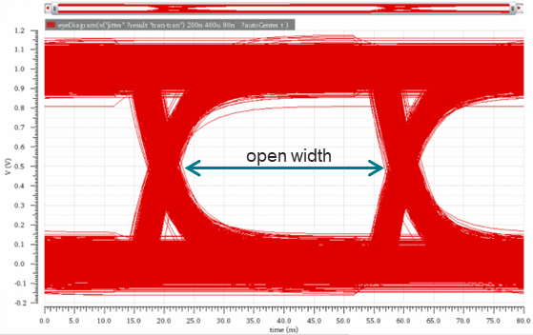
Measurement Generation
Instruction
Create an eye diagram for v(“output_jitter” ?result “tran-tran”)
from 200.0n to 500u with a period of 10n. Return the open width of the eye using eyeMeasurement.
A real case
Output
eyeMeasurement(
wave_eyeDiagram(
v("output_jitter"?result "tran-tran")
200.0n
500u
10n
?autoCenter t )
?horizThreshold 0 ?startx0 40 ?starty0 0 ?xTypePercent0 "t“
?endx0 60 ?endy0 50 ?yTypePercent0 "t“
?startx1 40 ?starty1 50 ?xTypePercent1 "t“
?endx1 60 ?endy1 100 ?yTypePercent1 "t“
?noOfBins 10
?measure "width“
)
This is one example of many kinds of measurements where it is much easier for a designer to describe what they want than to figure out how to write complex SKILL code
Notes:
This example is working today, and we expect to add support for a variety of measurements prior to the Virtuoso 25.1 release in mid-2025.

Slide 18
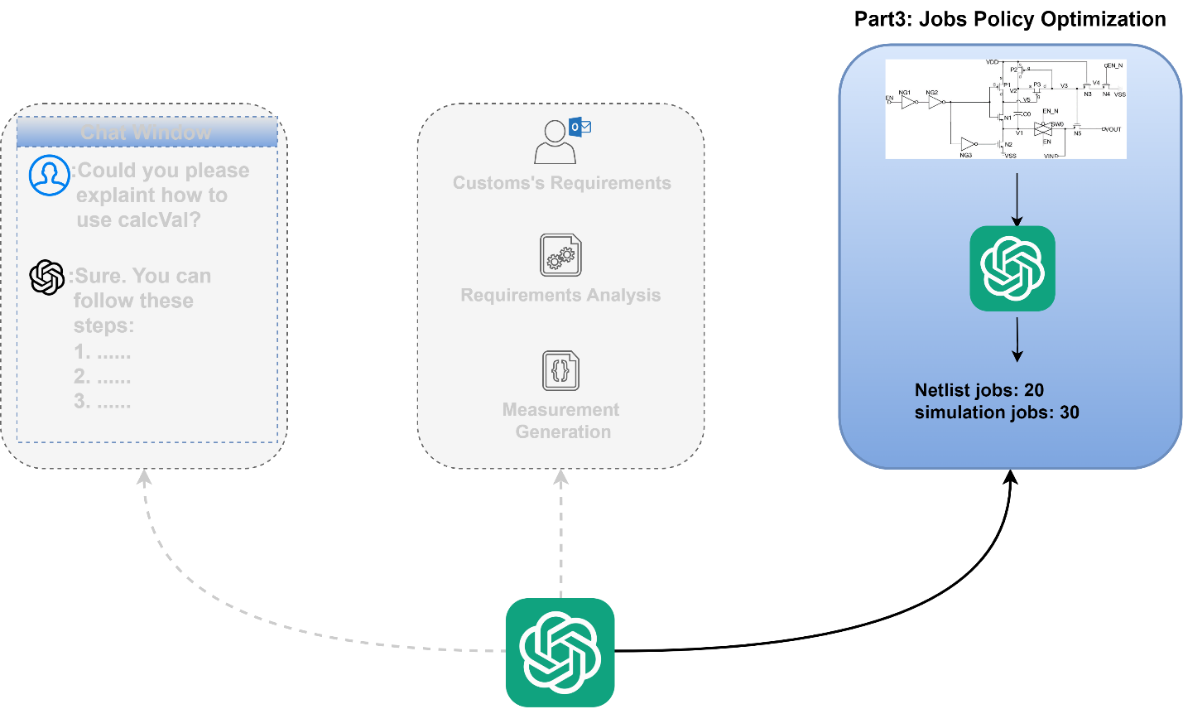
Job Policy Optimization

Slide 19
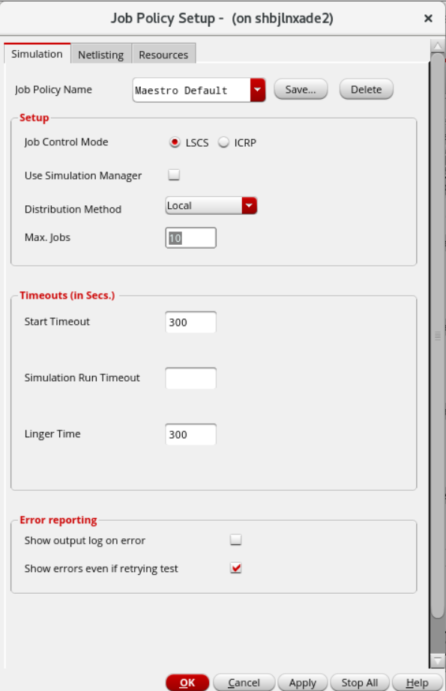
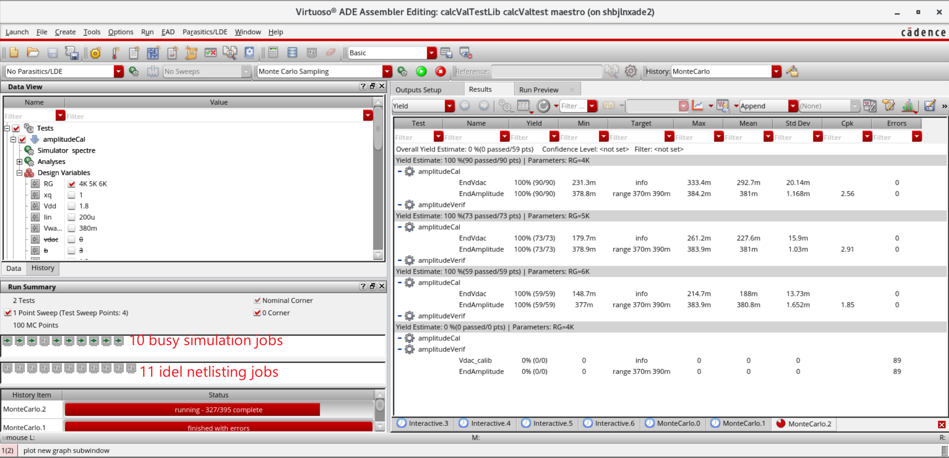
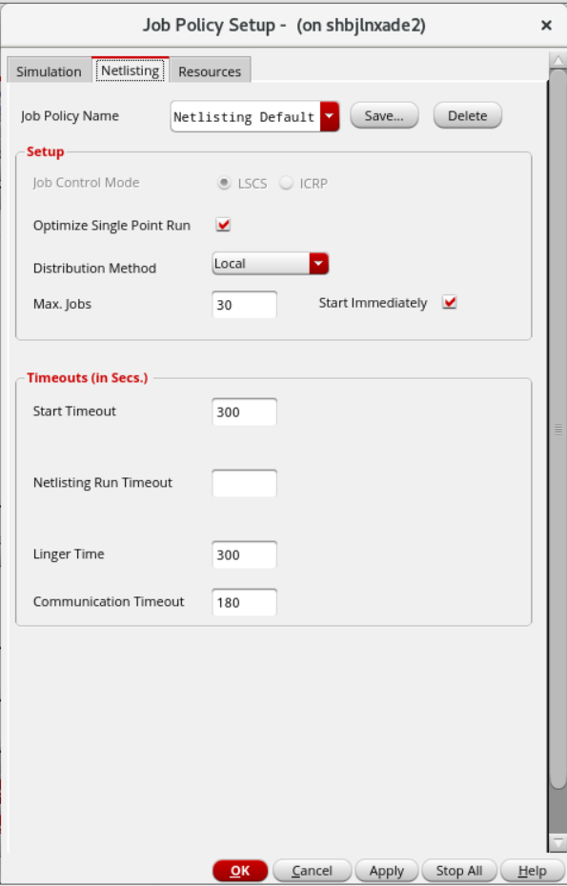
Job Policy Optimization
Problem to resolve
Improper setting of job policy leads to waste of resources

Slide 20
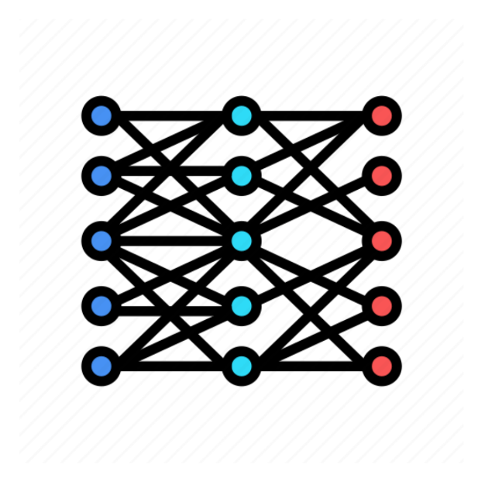
Job Policy Optimization
How ADE Copilot solves this problem
Fine Tune pre-trained LLM based on circuit dataset
ID | Circuit | Tran analysis stop time | Simulation points
1 | 1-stage common-source amplifier | 10s | 1000
2 | 3-stage common-source amplifier | 100s | 600
3 | common-drain amplifier | 80s | 500
… | … | … | …
X
ID | Netlist jobs | Simulation jobs
1 | 10 | 12
2 | 20 | 46
3 | 40 | 16
… | … | …
ADE Copilot training
Y
Data Set

Slide 21
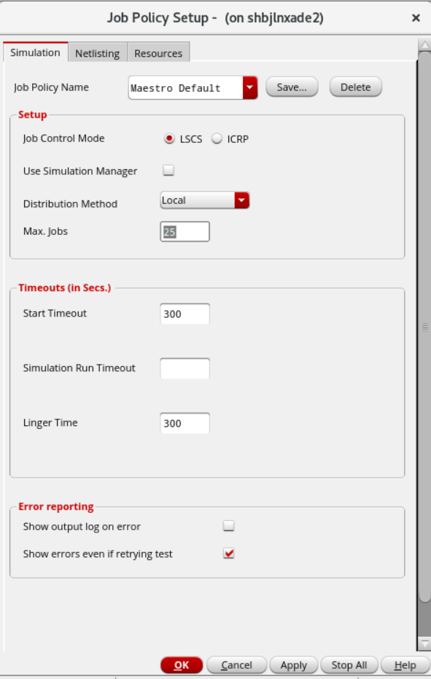
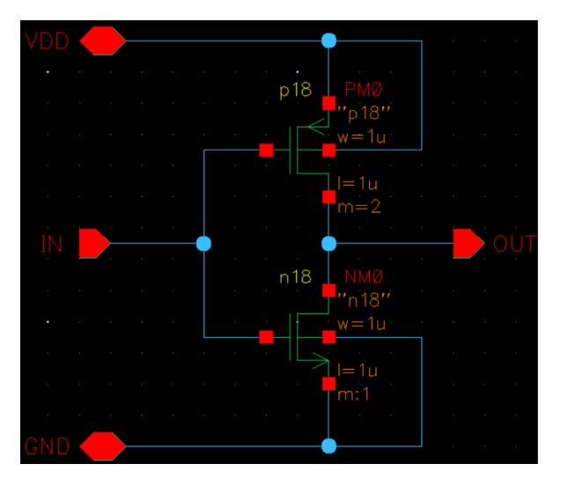
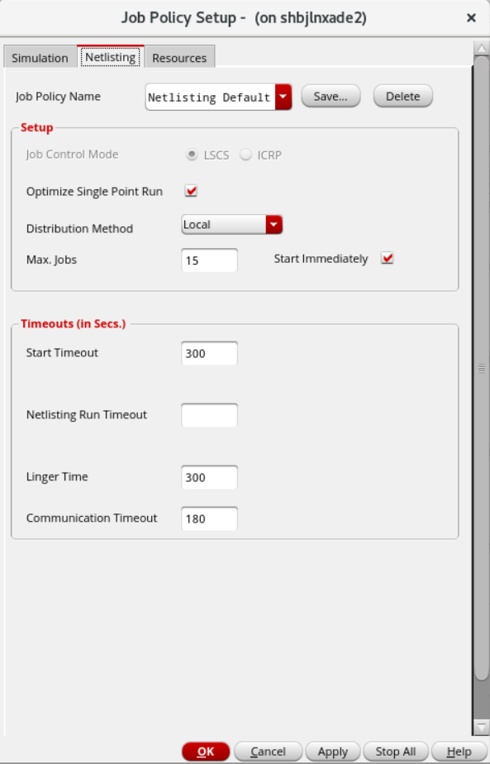
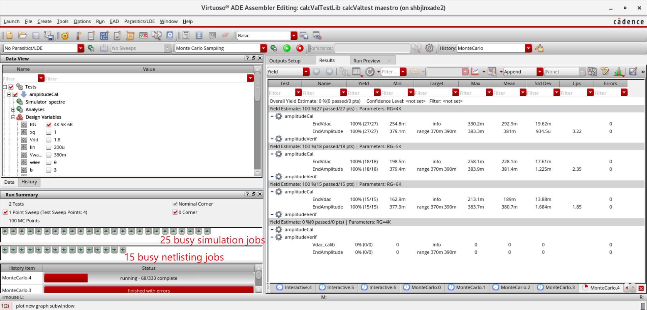
Job Policy Optimization
How ADE Copilot solves this problem
Get the optimal settings for job policy
ADE Copilot Inference
Schematic Design
Setting Job Policy Automatically
Reasonable Allocation of Resources

Slide 22
Summary

Slide 23
Summary
LLMs offer transformative capabilities in understanding and generating natural language
ADE copilot is an intelligent optimization engine based on LLM, which can assistant designer and improve simulation performance
Simplify reusing existing designs
Learn from a customer’s existing designs and documentation
Apply what it learns to assist the designer and to guide automation
ADE copilot has three applications currently, the first two applications already have prototypes
ADE Chatbot
Answer questions interactively about how ADE works and circuit design
Measurement Generation
Process the custom’s natural-language-requirements and generate skill measurement
Job Policy Optimization
Smart to set job policy automatically to improve simulation performance
VentureBeat made with OpenAI DALL-E 3 via ChatGPT Plus

